Slide 1
Machine Learning Proposal
Group 35

Slide 2
Agenda
01
Team Members info
04
Expected Result and Conclusion
02
05
Introduction and Related Works
Project Timeline
03
Proposed Method and Experimental Setup
06
References

Slide 3





Team Members
戴凱麗 111000277
農政宇 111000272
謝嘉銘 111000279
施淙綸
110020007
王籽穎
112060062

Slide 4
Introduction and Related Works
01
Feeling overwhelmed but no one to talk to?
02
What if you had instant emotional support?
03
Can a chatbot truly understand your feelings?
04
How can tech help with emotional well-being?

Slide 5



Introduction and Related Works
Text-based Chatbots
-rely on text communication
-lacks the ability to fully convey emotional nuances
Speech Emotion Recognition (SER)
-allows the system to detect emotions directly from voice inputs
-making interactions more natural and empathetic.
Natural Language Processing (NLP)
-respond according to the content of the conversation
-provide meaningful and context-aware feedback

Slide 6

Introduction and Related Works
Smart Chatbot with Emotion Recognition
Caring for your emotions
The Best Listener for Students
An Intelligent Emotion Assistant
Build a smart chatbot capable of voice conversation that can provide intelligent responses based on students' emotions

Slide 7

Proposed Method and Experimental Setup
Speech Emotion Recognition
Identify emotional states
Intelligent chatbot
Natural Language Processing
Generate context-specific responses based on the detected emotions
Text-to-Speech
Converts text into spoken audio
Speech-to-Text
Convert audio into
text transcriptions

Slide 8
Proposed Method and Experimental Setup
Speech Emotion Recognition (SER)
CNN-RNN model
(e.g. LSTM)
Intelligent chatbot
Natural Language Processing (NLP)
Pre-trained NLP models
(e.g. GPT/ LLM/ BERT)
Text-to-Speech (TTS)
Fine-tune TTS model (e.g. Tacotron/ VITS/ WaveNet)
Speech-to-Text (STT)
Fine-tune DL/ ASR models
(e.g. DeepSpeech/ Whisper/ Wav2Vec)

Slide 9
Proposed Method and Experimental Setup
Collect the data
Prepare the data
Emotional speech
Voice samples labeled with emotions
Train a model
Build SER & NLP model
Improve
Evaluate the model
Integrating model into the chatbot
Combined

Slide 10
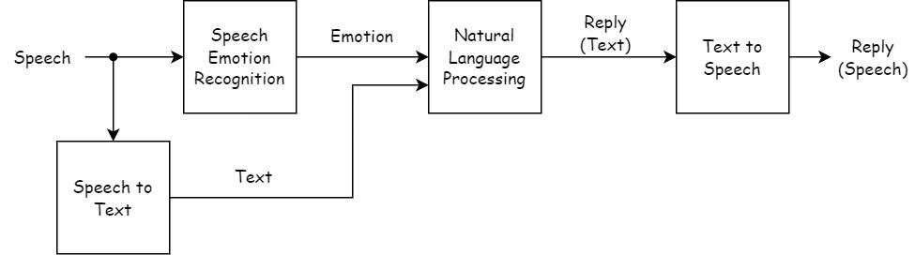
Proposed Method and Experimental Setup

Slide 11
Expected Result and Conclusion
01
Accurate emotion detection from voice inputs
EmoLingo
Intelligent emotional assistant
01
Intelligent chatbot
02
Appropriate text or voice responses based on emotion
Helps manage emotions through voice-based interactions
02
03
Both random and targeted replies for user interaction
Provide empathetic and supportive responses
03
04
Enhanced emotional support for students in real-time
Showcase AI’s role in improving emotional well-being
04

Slide 12
Project Timeline
Date | Phase | Task | Event
09/15-09/28 | Week3-4 | Team Building & Topic
09/29-10/12 | Week5-6 | Research on Related Works & Proposal | 10/08 Exam 1
10/13-10/19 | Week7 | Research on Related Works (Model) | 10/17 Proposal Submission
10/20-10/26 | Week8 | Finalize Task Assignments
10/27-11/02 | Week9 | Begin Training Models
11/03-11/16 | Week10-11 | Report Model Progress
11/17-11/23 | Week12 | Integration | 11/14 Exam 2
11/24-12/07 | Week13-14 | Final Evaluation & Submission | 12/05 Project Video
12/08-12/19 | Week15-16 | Project Presentation | 12/10 Exam 3 12/12 & 19 Present

Slide 13
References
https://www.sciencedirect.com/science/article/pii/S0747563221004453
https://www.smatbot.com/blog/chatbots-and-emotional-intelligence-can-ai-really-understand-human-emotions/
https://www.airitilibrary.com/Article/Detail/22259481-N202409130004-00007
https://www.airitilibrary.com/Article/Detail/U0002-1707201901010900
https://github.com/YasminSalehi/emotion-aware-chatbot
https://www.kaggle.com/datasets/uwrfkaggler/ravdess-emotional-speech-audio
https://www.kaggle.com/datasets/abdallahwagih/emotion-dataset

Slide 14
THE END
Thanks For Listening~

